Slide 1


WELCOME TO TERM THREE OF 2024 AQUACULTURE COURSE (SA220)
Joseph Mphande
MSc Sustainable Aquaculture –University of Stirling, UK
MSc -Aquaculture and Fisheries Science-LUANAR, Malawi.
Email: josephmphande90@gmail.com

Slide 2
NOTICES
We shall have a test 3
We shall have an assignment (Class based)
Class notes are encouraged
We shall do revisions (Question based) student led

Slide 3
PRESENTATION-JOSEPH CHUMA
5 MINUTES PRESENTATION
5 MINUTES QUESTIONS
Initial marks to be allocated by the class reps and the group leader

Slide 4

AQUACULTURE ENTERPRENEURSHIP

Slide 5
AQUACULTURE VALUE CHAIN
What is the meaning of Value chain?
The set of intertwined businesses and actors that participate in the coordinated production and value-adding activities needed to make products that consumers are prepared to purchase.
What is aquaculture value chain?

Slide 6
AQUACULTURE VALUE CHAIN
Generic aquaculture value chain.
Adapted (Kaminski et al., 2018). https://doi.org/10.1016/j.aquaculture.2017.12.010

Slide 7
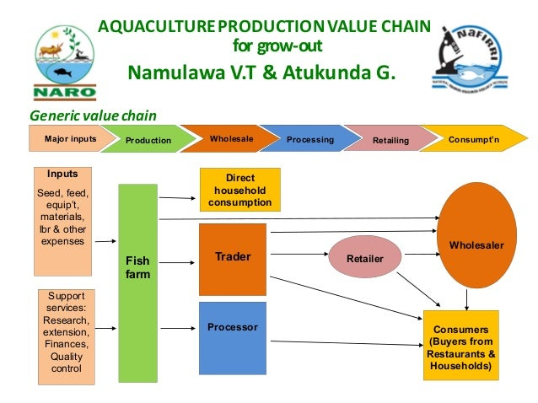
AQUACULTURE VALUE CHAIN
Generic aquaculture value chain.

Slide 8
AQUACULTURE VALUE CHAIN
Aquaculture value chain focuses on improve business linkages through out the chain in order to make the chain perform better and in a competitive manner.
Caution: The performance of one actor is affected by the actions of the others, which results in either a good or poor performance of the entire chain.

Slide 9
AQUACULTURE VALUE CHAIN
MERITS OF A FUNCTIONAL AQUACULTURE VALUE CHAIN
Benefits differ depending on a given player or actor in the Value chain for instance,
The benefits for a small farmers would; increased income, secure linkages to markets, and access to new services to aid production.
But for a Processors, improved quality and flow of raw materials, reduced transaction costs would be the merits that they obtain from the value chain.
.

Slide 10
AQUACULTURE VALUE CHAIN
MERITS OF A FUNCTIONAL AQUACULTURE VALUE CHAIN
Further, for a traders, having access to reliable supply of products, higher quality products maybe some of the advantages of the a value chain that is properly functional
To the Government, it reduces the regulatory burden and is an avenue for local resources mobilisation through tax.

Slide 11
ENTERPRENEURSHIP
WHAT IS ENTERPRENEURSHIP?

Slide 12
ENTERPRENEURSHIP
WHAT IS ENTERPRENEURSHIP?
Entrepreneurship is about creating or establishing a business.
Entrepreneurship is a dynamic, social process where individuals, alone or in
collaboration identify financial opportunities and act upon them by establishing
new enterprises.
But it is more than simply starting or operating a small business because it is both a science and an art.

Slide 13
ENTERPRENEURSHIP
WHAT IS ENTERPRENEURSHIP?
The process of identifying business opportunities, allocating resources, and taking risks to produce goods and services of value, through creative and innovative processes, to satisfy unmet consumer demands.

Slide 14
ENTERPRENEURSHIP
We note that;
Has impact on individuals
Provides financial opportunities.
Has an impact on the economic well‐being of a society.
Requires Innovation.
Is dynamic.

Slide 15
ENTERPRENEURSHIP
Who is an entrepreneur?
An entrepreneur is someone (person) who in pursuit of profits and at a risk makes the most of the opportunities in the environment by combining the expertise and resources of the community in different ways to produce products and services for the market (Cronje et al 2001) .

Slide 16
ENTERPRENEURSHIP
Who is an entrepreneur?
Be a risk taker, Be innovative, Possess business acumen and See potential opportunities in the community.
There are four main process that entrepreneurs have to o through according to Nieman et al. (2003).

Slide 17
ENTERPRENEURSHIP
Background to an entrepreneur.
During the ancient period the word entrepreneur was used to refer to a person managing large commercial projects through the resources provided to him.
In the 17th Century a person who has signed a contractual agreement with the government to provide stipulated products or to perform service was considered as entrepreneur.

Slide 18
ENTERPRENEURSHIP
Background to an entrepreneur.
In the 18th Century the first theory of entrepreneur has been developed by Richard Cantillon. He said that an entrepreneur is a risk taker. If we consider the merchant, farmers and /or the professionals they all operate at risk. For example, the merchants buy products at a known price and sell it at unknown price and this shows that they are operating at risk.

Slide 19
ENTERPRENEURSHIP
Background to an entrepreneur.
The other development during the 18th Century is the differentiation of the entrepreneurial role from capital providing role. The later role is the base for today’s venture capitalist.
In the late 19th and early 20th Century an entrepreneur was viewed from economic perspectives. The entrepreneur organizes and operates an enterprise for personal gain.
In the middle of the 20th and early 21thCentury the notion of an entrepreneur as an inventor was established.

Slide 20
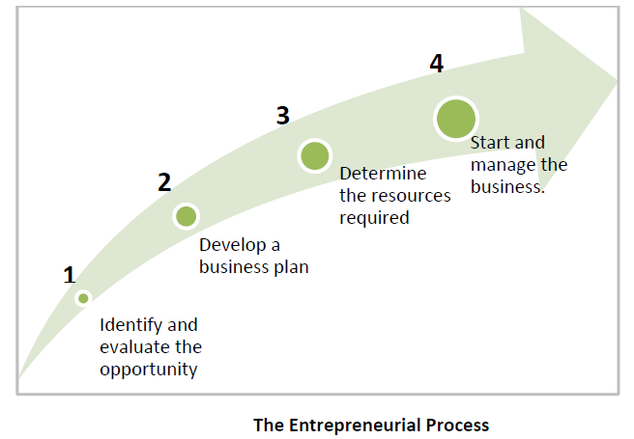
ENTERPRENEURSHIP
Who is an entrepreneur?

Slide 21
ENTERPRENEURSHIP
1. Identifying a Need
  A need can be an opportunity and indeed a consumer buys to satisfy need. Abraham Maslow in his humanistic hierarchy of needs, physical needs to very high personalized needs.
  Therefore identifying an unidentified or unserved need is a sure way of generating business ideas.

Slide 22
ENTERPRENEURSHIP
1. Identifying a Need
  Brain Storming
  This is a process of detaching analysis of an idea from the actual ideas.
  The idea may or may not be related to a given product. In brainstorming even silly and stupid ideas may be generated.

Slide 23
ENTERPRENEURSHIP
1. Identifying a Need
Building on One’s Skill, Hobbies or Interests
  Business ideas can be generated through
  1. personal interests and hobbies
  2. Copying or improving somebody’s ideas ( skills)
Sporting a Market Niche
  Entrepreneurs usually look for gaps in the growing markets, identifying market sections which are not being utilized.

Slide 24
ENTERPRENEURSHIP
1. Identifying a Need
.
Listening to what People say.
  These are people who simply say or speak their needs e.g if these good bus services
Attribute listening
  This method of generating business ideas is based on changing the way one looks at something in order to find a new use for it.
  It attempts to answer the question – what do we do with this product.
Gaining from Waste
  What would appear waste can be used- say recycles to create a new opportunity.

Slide 25
ENTERPRENEURSHIP
2. Developing a business idea
.
The Process of Screening a Business Idea.
  After generating business ideas- it is important that some evaluation through a screening process be made.
  The screening process is a systematic evaluation ideas in order to select the best idea which would suit one.

Slide 26
ENTERPRENEURSHIP
2. Developing a business idea
.
The Process of Screening a Business Idea.
  The screening process must be done carefully, objectively, soberly and without any emotions.
  The business idea screening is required even when there is only one idea to consider. This is because this is a stage of starting a business that may be not be profitable or may be difficult to run

Slide 27
ENTERPRENEURSHIP
2. Developing a business idea
.
The Process of Screening a Business Idea.
  The screening process must therefore evaluate the following
Personal Evaluation
  the objective for going to business
  personal interests
  The degree of commitment to the business or others e.g. family.
Personal Skills
  The self SWOT analysis – this aims at analyzing ones
Strengths
Weaknesses
Opportunities
Treats

Slide 28
ENTERPRENEURSHIP
2. Developing a business idea
.
“Strengths” and “Weaknesses” should focus on the internal environment (management, product/service), whilst “Opportunities” and “Threats” should focus on the external environment (economy, market and competitors).
Clearly, it is important that your business idea has significant strengths (or can develop them) and a plan to counter to any weaknesses.
Your business idea should be developed to take advantage of any opportunities and thought should be given to how you would respond to threats.

Slide 29
ENTERPRENEURSHIP
The screening process or evaluation helps identify;
Strengths: E.g. Distinctive competence, Adequate finances, Access to economies of scale, Good innovation ability, proven management
Weakness: E.g. Lack of key skill , Internal operations problems , Low morale , Poor track records , Weak internal image
2. Developing a business idea
A SWOT analysis should provide proof to you, your investors and funders etc., of the likelihood of your business succeeding or failing. If your analysis suggests it will fail you need to reconsider your idea.

Slide 30
ENTERPRENEURSHIP
2. Developing a business idea
The screening process or evaluation helps identify;
Opportunities: E.g. Potential customers , Potential goodwill , A favorable social environment
Threats: Strong competitions , Adverse government policies, Political instability, mismanaged economy , Unfavorable legislation.

Slide 31
ENTERPRENEURSHIP
2. Developing a business idea
Market evaluations
The aim is to create assurance of adequate market The main components include
i.)Consumer demand analysis
ii.) Product price and placements
iii.) No. of competitors in markets.
An analysis of availability of raw materials in terms of
i) Adequacy ii) Reliability
iii) Price
2. Developing a business idea
Analysis of providing technology in terms of
Appropriateness ii) Affordability
An analysis of skills available
Analysis of the government policies.

Slide 32
ENTERPRENEURSHIP
Characteristics of a Good Business idea.
i) Easy to manage and involve minimal risk. ii) Does not require excessive capital investments iii) Offers a good returns on capital iv) The idea has scope for growth, expansion and diversification
v) Comparative with owner’s goal and interest vi) Not against expectation of the society v) Has a short gestation period vi) Has a readily available market vii) Easy to exit when necessary.

Slide 33
ENTERPRENEURSHIP
SUMMARY
Entrepreneurship is a business process and the entrepreneur is a person involved in
the entrepreneurial process.
Important aspects of entrepreneurship include: identifying an opportunity, innovation
and creativity, gathering resources, creating and growing a business, taking risks, being
rewarded and managing the business.

Slide 34
ENTERPRENEURSHIP
SUMMARY
The four steps in the entrepreneurial process are: identifying and evaluating an
opportunity; developing a business plan; determining the resources required and then
lastly starting and managing a business.

Slide 35
THE ROLE OF ENTREPRENEURSHIP IN SOCIETY
Generic aquaculture value chain.
Entrepreneurship as a whole contributes to a society’s social wealth by creating new markets, new industries, new technology, new institutional forms, new jobs and net increases in real productivity.

Slide 36
THE ROLE OF ENTREPRENEURSHIP IN SOCIETY
The jobs created by entrepreneurship in turn lead to equitable distribution of income, which results in higher standards of living for the population.
In this way, the resources available to government also increases, the tax base grows.
Additional taxes enable governments to improve social services, like hospitals and schools, to enhance infrastructure and to keep law and order.

Slide 37
THE ROLE OF ENTREPRENEURSHIP IN SOCIETY
The benefits that entrepreneurship can have for society, including individuals, families and the community are provided and discussed by Benade et al. (2011) as follows;
1. Employment opportunities
Entrepreneurship not only offers self‐employment opportunities, but also creates employment for others, often better jobs.
Self‐employment offers more job satisfaction and flexibility of the work force.
Such job creation initiatives utilise the human resources of the particular country and helps the natural talent materialise.

Slide 38
THE ROLE OF ENTREPRENEURSHIP IN SOCIETY
2. Income generation and fewer social problems
Successful entrepreneurship activities increase the income level of the average person, and also the standard of living in the community.
Individuals who search for business opportunities usually create wealth through entrepreneurship.
This wealth plays a considerable role in the development of a nation.
If more people are employed more people pay taxes, which means more income for the government.

Slide 39
THE ROLE OF ENTREPRENEURSHIP IN SOCIETY
2. Income generation and fewer social problems
It also means that the crime rate will go down and the country can become a safer location with more tourists willing to visit the country.
If tourism increases, more job opportunities will become available and more people will be employed.
Entrepreneurship can also attract more foreign investment, which in return can also create more job opportunities.

Slide 40
THE ROLE OF ENTREPRENEURSHIP IN SOCIETY
3. Personal Challenge
Entrepreneurship is a challenging task, but if successful the rewards are worth the effort.
Rewards for an entrepreneur can be both financial and personal.
The entrepreneur gains self‐satisfaction and confidence as he or she succeeds.

Slide 41
THE ROLE OF ENTREPRENEURSHIP IN SOCIETY
4. Improvements in Industry
Entrepreneurship leads to the development of more industries, especially in rural areas or regions where there are very few economic activities.
This does not only mean more goods and services, but also higher quality products, because of healthy competition between the different businesses.

Slide 42
THE ROLE OF ENTREPRENEURSHIP IN SOCIETY
5. Higher productivity and economic growth
More industries can create higher production at lower prices.
Entrepreneurship encourages the use of local materials to produce finished goods for domestic consumption, as well as for export.
Entrepreneurship enables the country to produce more and more goods locally and thereby build its capacity and resources.
With the new inventions and development in technology, a nation can use its resources more effectively.

Slide 43
THE ROLE OF ENTREPRENEURSHIP IN SOCIETY
5. Higher productivity and economic growth
If we change our raw materials into consumable goods we add value to our products, which means that we can now receive a much higher price and at the same time create more jobs.
With the new inventions and development in technology, a nation can use its resources more effectively.

Slide 44
THE ROLE OF ENTREPRENEURSHIP IN SOCIETY
6. Increases in exports and less dependence on imports
Entrepreneurship leads to the development of new markets.
If we produce more, we can export products that are not sold locally.
This means that a country’s products can also enter foreign markets.
From time to time a country’s government officials sign agreements with other countries to promote trade.

Slide 45
THE ROLE OF ENTREPRENEURSHIP IN SOCIETY
6. Increases in exports and less dependence on imports
Currently many developing countries (including small states) rely heavily on imports, especially from the developed nations.
Exports must exceed imports in order to create an economic advantage.
Earnings from exports inevitably stimulate the economy.
These are opportunities that should be taken into account when we are planning and growing our new
business.

Slide 46

THE ROLE OF ENTREPRENEURSHIP IN SOCIETY
What demotivate people to Entrepreneurship?

Slide 47
THE ROLE OF ENTREPRENEURSHIP IN SOCIETY
What demotivate people to Entrepreneurship?
Lack of proper information
Fear of competition. Fear of taking risk
Inhibiting government laws
Lack of adequate start-up capital
Lack of knowledge and skills
Wrong attitudes towards employment

Slide 48
THE ROLE OF ENTREPRENEURSHIP IN SOCIETY
Summary
it is clear that entrepreneurship improves the economy and creates a better place to live. Entrepreneurship definitely offers many advantages to individuals, families and the general community.
These advantages influence one another and are interwoven to create a multiplier effect.
When we become more creative, we can develop new and unique products.

Slide 49
THE ROLE OF ENTREPRENEURSHIP IN SOCIETY
Summary
As we succeed, we become proud of our achievements, and we are motivated to increase our production.
When we produce more goods, we can lower our need for imports and have excess goods for export, while simultaneously creating jobs.
Entrepreneurship is advantageous, but it also involves hard work and sacrifices

Slide 50
ECONOMIC, SOCIAL AND POLITICAL FACTORS AFFECTING ENTREPRENEURIAL DEVELOPMENT
a) High taxation levels. For business and personal incomes which in effect reduce profits earned making it un-attractive to engage in business and Taxation of raw materials and other inputs raise production costs.
b) Corruption and official harassment
Occurs where entrepreneurs are forced to bribe officials in various government departments to allow operation or start up.

Slide 51
ECONOMIC, SOCIAL AND POLITICAL FACTORS AFFECTING ENTREPRENEURIAL DEVELOPMENT
c) Unregulated competition from the outside world due.
Liberalization which opened importation competing locally produced goods.
d) Declining personal incomes of people due to
Over-increasing cost of living and Arise in unemployment
e) The high cost of finance
The cost of borrowing is high and Business collapses because they lack ability to repay loans.

Slide 52
ECONOMIC, SOCIAL AND POLITICAL FACTORS AFFECTING ENTREPRENEURIAL DEVELOPMENT
f) Lack of necessary skills and knowledge due to
Lack of training opportunities and High education costs.
g) Poor transport and communication network
Making business difficult, Inconveniencing consumers, High energy costs and Lack of entrepreneurial culture

Slide 53
ENTREPRENEURIAL COMPETENCIES
LEADERSHIP
Ability to inspire, influence, persuade others to give maximum effort and cooperation willingly and voluntarily towards the attainment of the unplanned goals.
Good leadership is a necessity in any business organization (Key to show leadership behavior, leading and motivating others, leaders influence and activities)

Slide 54
ENTREPRENEURIAL COMPETENCIES
Leadership Behavior
As a leader, your should have the following qualities:
Vision and foresight: you should look into the future when making plans, you need vision in order to be able to determine how you want your business to develop
Strong desire to influence others: You can influence your staff if they have confidence and trust in you. Ability to learn from past errors and build on past experience (Avoid mistakes)

Slide 55
ENTREPRENEURIAL COMPETENCIES
Leadership Behavior
High ambition: Should always aim high and for the best in your undertakings and expectations.
Imagination: as a leader you should see beyond the horizon
Creativity: You should be as original as possible in ideas and activities (Try new methods or ways of operation).
Initiative: as a leader, you have the role of getting things started. You should also find new and better ways of doing things you are the agent of change.
Good human relations: as a leader you should sell good image of your business.

Slide 56
ENTREPRENEURIAL COMPETENCIES
Leading and Motivating Others
As an entrepreneur success depends on how you motivate your employees. The following techniques should be employed:
Built Workers self-esteem:By praising the good work done by your employees, you are building confidence in selves. Appreciate what they have done.
Inform employees: Tell your staff what you are trying to accomplish.
Delegation of authority and responsibility: Good delegation will allow you as a leader to devote more time to important and crucial issues within your business.

Slide 57
ENTREPRENEURIAL COMPETENCIES
Leading and Motivating Others
Maintain contact: know your staff well enough by maintaining personal contact.
Apply reinforcement principal: you should reward behaviours that you consider desirable because people tend to repeat rewarded behavior. Don’t reward undesirable

Slide 58
ENTREPRENEURIAL COMPETENCIES
Leading and Motivating Others
Be an active listener: By active listening you will be an effective communicator which is an important quality of a leader. Your employees will take it that you appreciate them and have concern in them.
Set specific goals: set specific clearly understood measurable goals and continuously review them.
Take collective action- When you must deal with some negative aspects of a workers performance you should talk to that worker in private, never criticize a worker in public

Slide 59
END
THANK YOU FOR LISTENING/WRITING YOUR OWN NOTES
QUESTIONS

Slide 60
CHARACTERISTICS OF AN ENTREPRENEUR
Being an entrepreneur is not easy. In order to succeed, entrepreneurs must demonstrate specific characteristics.
Let’s look into these characteristics a bit further as presented by VUSSC, (2011).

Slide 61
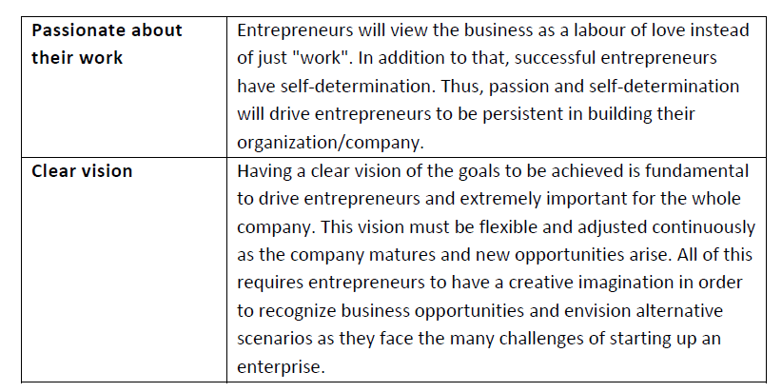
CHARACTERISTICS OF AN ENTREPRENEUR

Slide 62
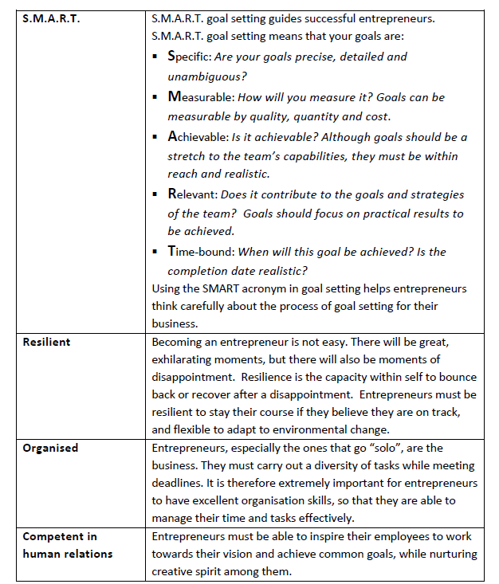
CHARACTERISTICS OF AN ENTREPRENEUR

Slide 63
CHARACTERISTICS OF AN ENTREPRENEUR

Slide 64
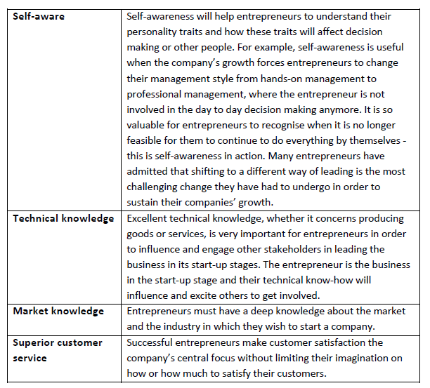
CHARACTERISTICS OF AN ENTREPRENEUR

Slide 65
CHARACTERISTICS OF AN ENTREPRENEUR

Slide 66
LEADERSHIP OF ENTREPRENEURS
Leadership styles are divided into three classification;
  1. Autocratic Style
  The oldest and most traditional form of leadership style. In this style, the manager draws a very firm discipline line.
  Everybody knows what he/she can or cannot do. Many like this form of leadership because it gives a sense of purpose and security.
  They know what is expected of them and they know that they must leave upto certain standards.

Slide 67
LEADERSHIP OF ENTREPRENEURS
Leadership styles are divided into three classification;
2. Laissez Faire / Free-Reign
A very permissive type of style, employees are left alone to reach their own potential.
Some people are responsive to these style and do not abuse their freedom, others take advantage of the climate and do not leave up to their potential.

Slide 68
LEADERSHIP OF ENTREPRENEURS
Leadership styles are divided into three classification;
3. Democratic Style
This style depends upon the organization, its objectives and the personalities of its people.
In democratic climate a manager builds a sense of union and common interest among his/her workers.

Slide 69
LEADERSHIP OF ENTREPRENEURS
Leadership styles are divided into three classification;
3. Democratic Style
This style depends upon the organization, its objectives and the personalities of its It is at times even hard to recognize who the manager is.
Leaders set discipline lines against which nobody seems to object.

Slide 70
LEADERSHIP OF ENTREPRENEURS
Leadership styles are divided into three classification;
Most leaders use a combination of styles, depending on the group and the situations.
Theory X and Theory Y
According to Mc Gregory each manager will manage his employees according to his own attitudes and ideas about people, their needs and their motivations.
If an appointed a manager believes that individuals are naturally lazy, then he or she will treat subordinate employees in a certain way, such as issuing precise orders and exercising tight control over their work.

Slide 71
LEADERSHIP OF ENTREPRENEURS
For purposes of comparison he stated that the extremes in contrasting attitudes among managers could be classified as Theory X and Theory Y
Theory X | Theory Y
1.Inert, lazy, prodded | Naturally active, striving
2.Work for threat of hunger, loss of job | Work to achieve goals, find satisfaction, build good life
3.Pay is almost the only motive | Many motives, achievement, recognition, service
4.Dependent, must be directed, push, needs leader to inspire | Independent capable of self-directing, setting own goal
5.Irresponsible, immature, must be closely supervised and carefully checked | Mature, responsible, capable of self-correction
6.Conformists-needs prescribed routine and resist change | Inventive, adaptive, creative needs to device new ways
7.Satisfied with good pay | Seeks broader meaning in work life
8.Not to be trusted | Usually trusted

Slide 72
LEADERSHIP OF ENTREPRENEURS
Methods of Decision Making
These are several methods you can use to make business decisions, among them we have;
Rule of Thumb: A decision is made based on existing established procedures e.g. based on laws, customs, religion, etc. You can’t change
Committee Approach/ Team work: Its where using a selected number of people from the main group to make a decision which will be accepted by all.

Slide 73
LEADERSHIP OF ENTREPRENEURS
Methods of Decision Making
These are several methods you can use to make business decisions, among them we have;
Critical Path Analysis: This is making decision stage by stage until the final decision is reached.
Brainstorming: This is where all members of a group develop ideas for a solution

Slide 74
LEADERSHIP OF ENTREPRENEURS
Steps of the Decision Making process
Identify the major problem e.g. low productivity
Determine major causes of the problem e.g. low salaries, poor working conditions
Determine potential solutions – how to solve
Evaluate potential solutions
Select the best solution
Implement the solution
Verify the solution.

Slide 75
LEADERSHIP OF ENTREPRENEURS
Steps of the Decision Making process
Identify the major problem e.g. low productivity
Determine major causes of the problem e.g. low salaries, poor working conditions
Determine potential solutions – how to solve
Evaluate potential solutions
Select the best solution
Implement the solution
Verify the solution.

Slide 76
TIME MANAGEMENT
Time is a measure of life.
A unique resource, shared equally, cannot be stored, cannot be replaced once it is lost.
Time is an entrepreneurs scarcest resource & unless it’s managed, nothing else can be managed
Time Management is the management of the activities we engage in during our time to achieve a goal.
Some of the factors that contribute to time wasting in a business include;

Slide 77
TIME MANAGEMENT
WHAT CAN AN ENTREPRENEURIAL DO TO MANAGE THEIR TIME?
Notes:
Draw – up and action plan – ie “things to do list”
Set out priorities based on what is urgent and important
Schedule your time realistically

Slide 78
COPING WITH COMPETITION
Competition is the act to vie for customers or market.
Direct competitors. Services / Products which are similar to the same already in the market.
Indirect competitor. offering different kinds of goods/ services to the same market/customers.
Identification. Identify and list out names, location and activities of all your competitors.

Slide 79
COPING WITH COMPETITION
Analysis
You analyze yourself and your competitors on the basis of yourself and your competitors as follows:
  Market: What is your/ the market? What share of the market do you/they have? What advantages do you/they have in servicing your/their market segments?
  Product: How does your product quality compare with the competitors? What special services do you / they offer? Do you/they have a programme to improve your/their products? Is there a possibility of developing a new/ or improved product to satisfy new needs?

Slide 80
COPING WITH COMPETITION
Analysis
  Production: How do you compare your technology with the competitors? How do you compare sources of raw materials with those of your competitors? How do your skills (and those of your workers) compare with the competitors? What advantages / disadvantages does your / their location have?
  Finance: How do you compare your financial resources with your competitors?

Slide 81
COPING WITH COMPETITION
Analysis
  Government Policy: have you identified any opportunities or threats resulting from new or existing government policies(eg relaxation of import restrictions, introduction of VAT)
  Environment: Do changes in the general environment including the local communities offer any opportunities or threats to you for example there is a large number of young people whose tastes are different from the rest of society

Slide 82
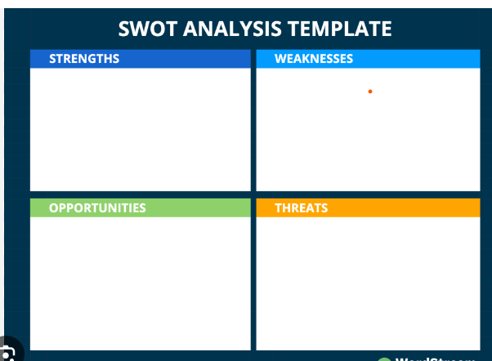
COPING WITH COMPETITION
Analysis
After obtaining answers to these and any other questions you develop arrange them in a strength/ weaknesses / opportunities and threats SWOT Table.

Slide 83
END
Thank you for listening

